Slide 1
Traffic Monitoring
Software Engineering Presentation

Slide 2
TABLE OF CONTENTS
01
01
02
02
03
05
04
03
05
06
06
Introduce
Objective
Here you could describe the topic of the section
Here you could describe the topic of the section
The traffic problem
Introduce the solution
Target Customer
Target Software
Requirement
BUDGET
System Require
Here you could describe the topic of the section
Here you could describe the topic of the section
Here you could describe the topic of the section
Functional Requirement
Non-functional Requirement
Use case
Class Diagram
ER and RR Models
GOALS & STRATEGY
Our Project
KPI OVERVIEW
Conclusion and Future Work
Here you could describe the topic of the section
Here you could describe the topic of the section
Snapshoot of out project
Tool and Framework
Our goal to next obective

Slide 3
01
Introduction
Traffic Problem Nowaday

Slide 4
Traffic Problem
There is nothing worse than being trapped in the car, waiting in the middle of a traffic jam. It is frustrating, knowing that there is nothing you can do and that you are going to be late to work. Traffic jams often occur during rush hour or right after a large event because there are more cars on the road than normal. Traffic jams can also be caused by car accidents or road construction. They usually occur on major roads that many people use to travel to work or school. Beside there another problem with the driver when they are offroad or lost in the highway, causing time wasting for them. People are willing of an mapping application service that can solve this problem.

Slide 5
Project Description
Our Traffic Monitoring system is a website which shows map and traffic severity along street and highway in the world pariculary in Viet Nam
Traffic map are based on historical weather and Google map API to collect map data
The Traffic Monitoring system is using Model View Controller systems.
User Interface System
Data Collection System

Slide 6

02
Objective
Planned Solution

Slide 7
Target Customer and Objective
Target
Normal people : using map when moving and searching
Driver: Travel a lots, they need map in order to drive smoothy
Student: Especially college students, search for place to play, to work in new city.
Objective
To provide an application that can acts like a personal assistant. Gives users an estimated time of arrival based on traffic conditions. See traffic patterns along a path (route) between two end-points, given time of the day and weather conditions.

Slide 8
Target Software
To access and use the Traffic Monitoring System, the user first opens their preferred internet browsing application / program and loads the project’s website. The user enters all pertinent information on this page to find traffic and weather information. The user point and clicks the button to see the map, and to find information about the desired area the user chooses to travel. The user then enters the time of day. Using a menu, the weather type is appear rain, snow, sun,..etc The user has an option to view three different sets of information. One choice is to see traffic route for the selected route. The second choice is to see map and way for the entire selected region. The third option is to overlay the map with live traffic condition from a live website (such as Google traffic/NJ traffic etc.). The user can select a region, time, weather, and optionally a road. Then the website will display a map plotting markers in sectors of the roads. However, now it will be implemented in PHP and using Google map API because Google maps is the best tool for map tracking .

Slide 9
Functional and Non Functional Requirements
03
Requirement

Slide 10
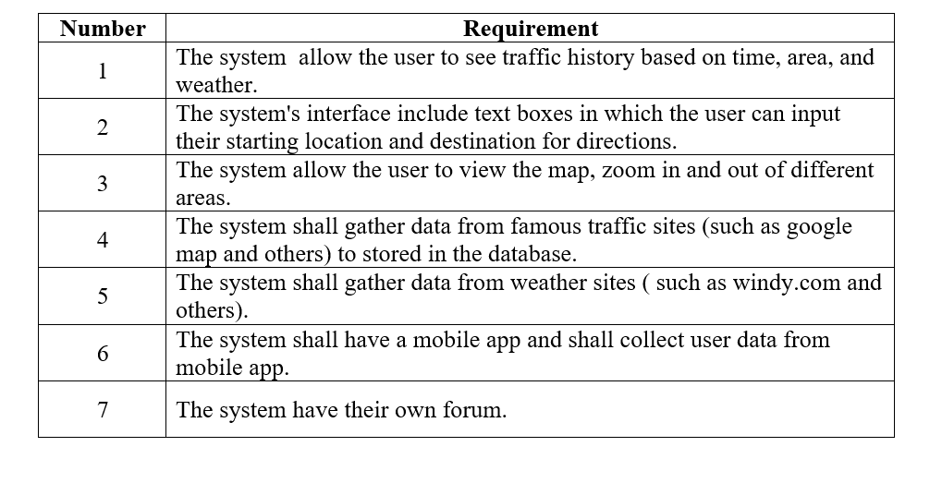
Functional Requirement

Slide 11
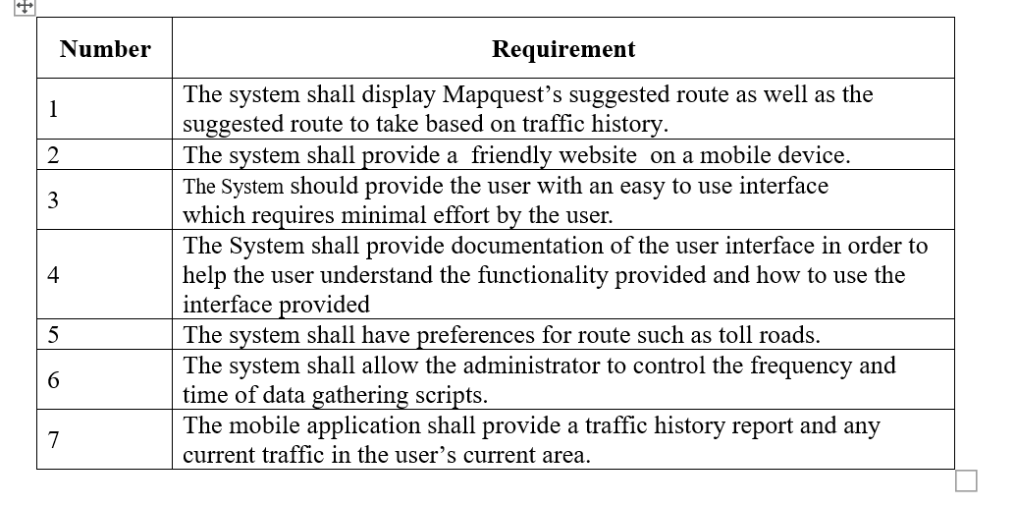
Non-Functional Requirement

Slide 12
04 System Require
Diagram

Slide 13
Use case
UC1
UC2
Mars is actually a
very cold place
It’s the closest planet to the Sun
View Traffic History
GetDirections
UC3
UC4
It’s the farthest planet
from the Sun
Saturn is the ringed one and a gas giant
Map Interface
Get Traffic Data
UC5
UC6
Neptune is the farthest
planet from the Sun
Jupiter is the biggest planet of them all
Get Weather Data
Sign In Concept

Slide 14
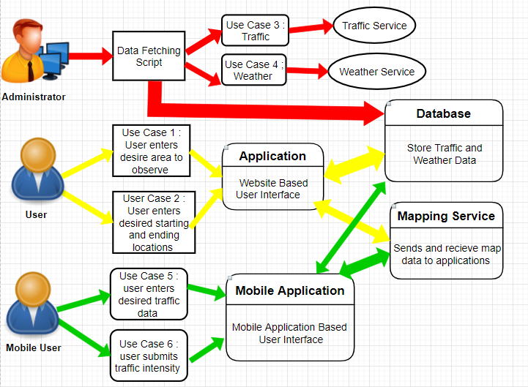

Slide 15
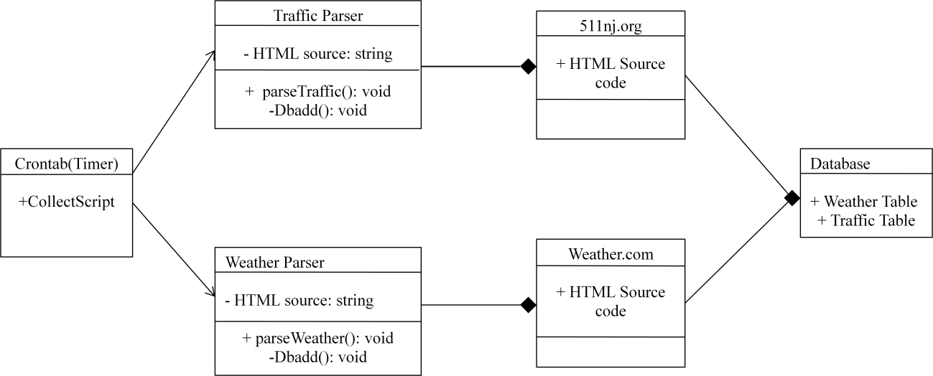

Class Diagram
For data collect system

Slide 16
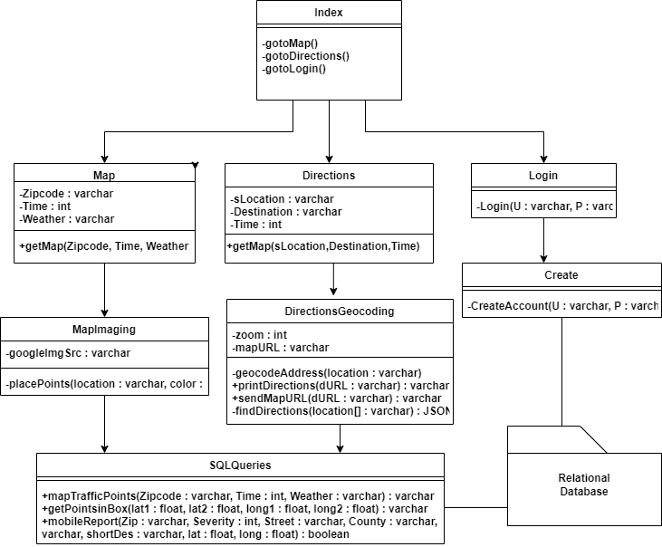
Class Diagram
Website

Slide 17
ER and RR Model

Slide 18

05
Our Project
Snapshoot of system
Tool and frame work

Slide 19
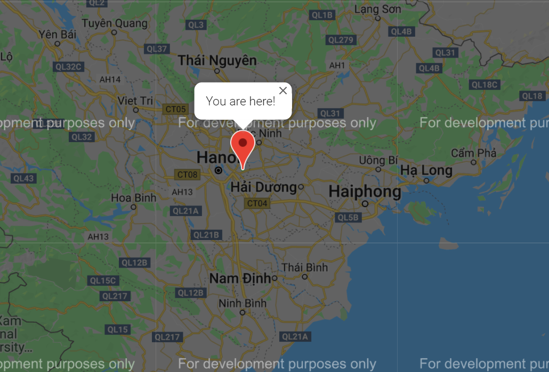
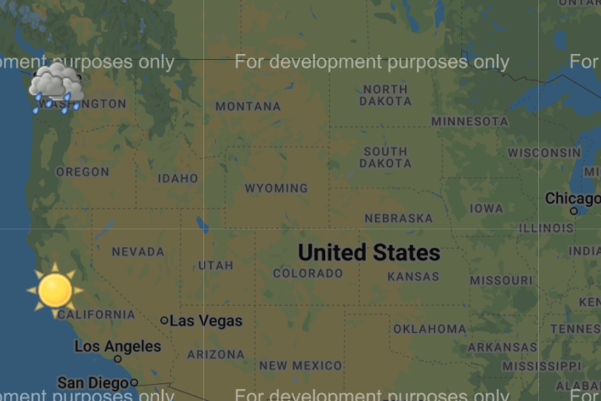
Some Snapshoot of System

Slide 20
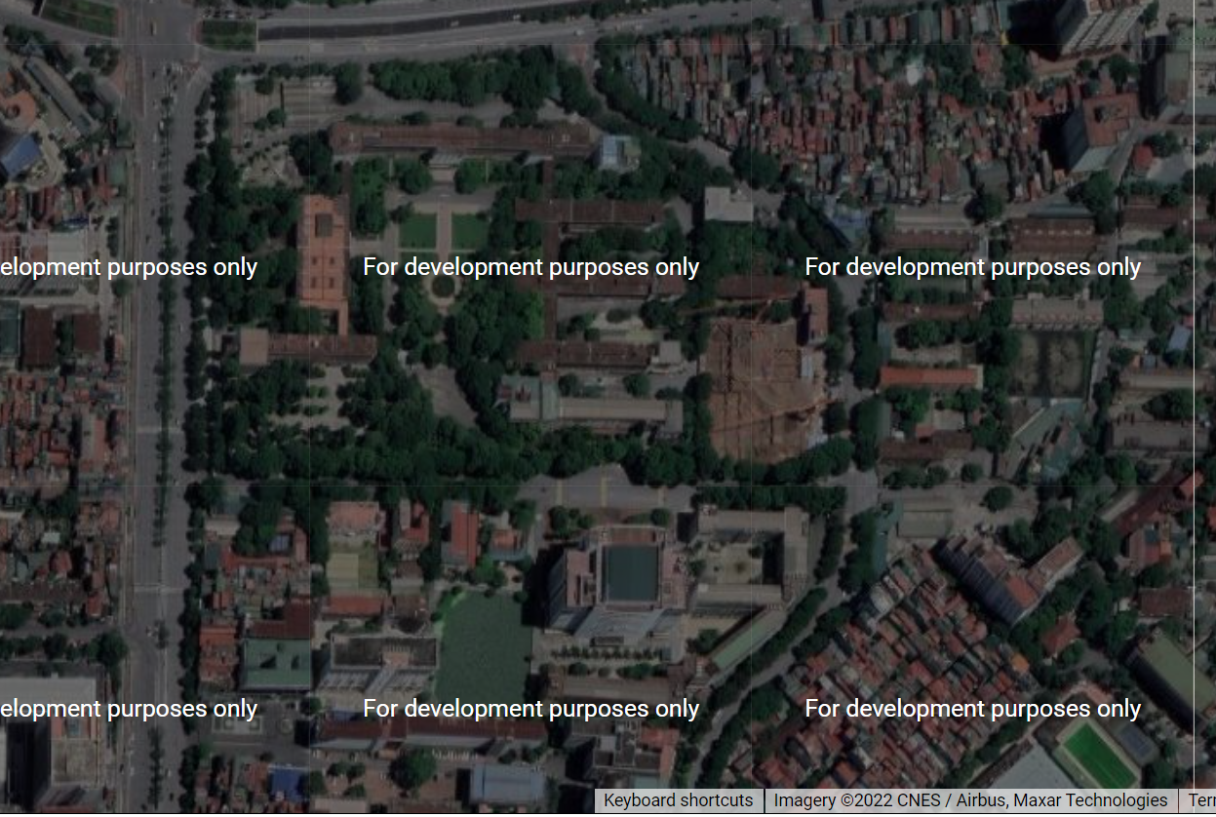

Slide 21
Tool and Frame work
HTML5
CSS Java
Using php
User Interface interacting
Google API

Slide 22
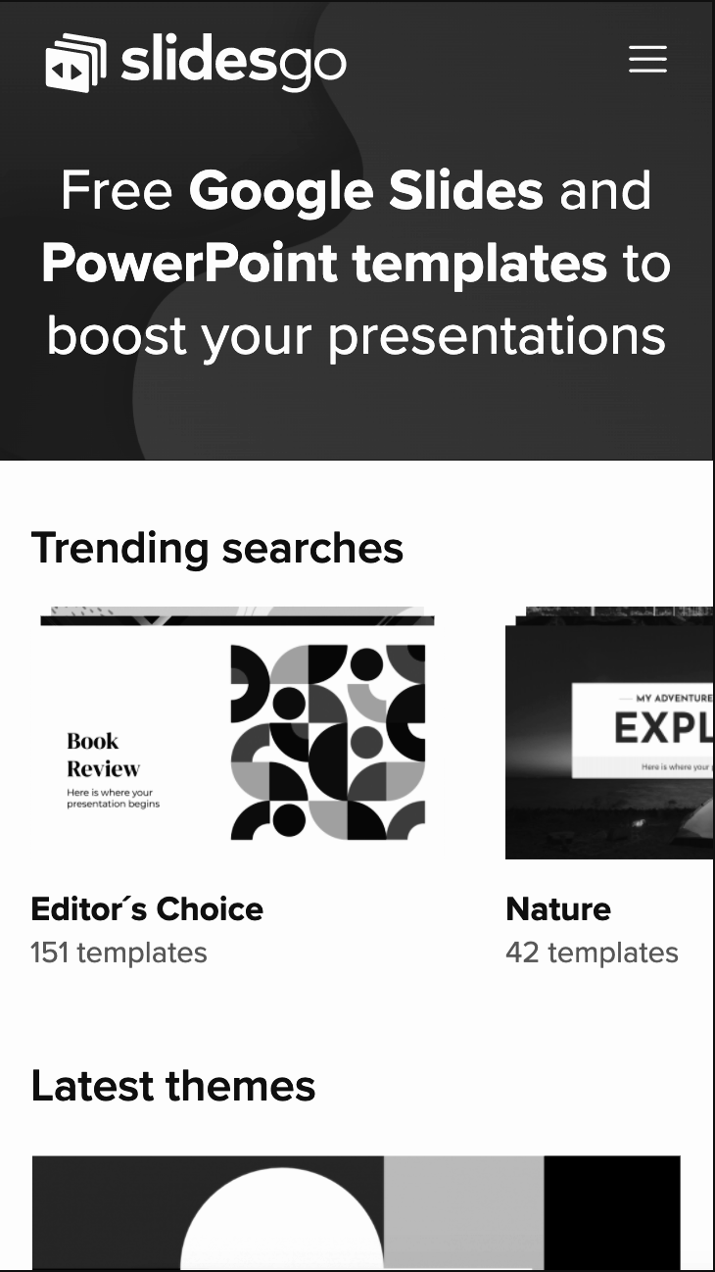
MOBILE WEB
06
Conclusion and Future Work
Our next goal is to port an app to a mobile device

Slide 23
Conclusion
Our final version, although much improved from the previous project, is still far from the standard we hoped it would be. Most of the other components were fairly straightforward and required less complexity in the code however the code needed to be extensive and sufficiently fault-tolerant.
We are using API provided by Google more extensively in order to provide more user-friendly features. Furthermore, our project is too complex that we have no choice but to exclude the traffic report from the web.
In the end there seem to be a lot of improvements we could make given an appropriate amount of time to continue developing the project. However, we are quite happy with our level of implementation and the features we have made available.

Slide 24
Future Work
We propose that social networking could be a very important too in collecting information about incidents occurring in small local or county roads. We will work to make add a traffic predictor in our system as soon as possible. Since there aren’t many mapping systems (apart from Google Maps) has feature like road traffic predicting, we that this would be a great upgrade.
Beside that, we plan on moving our system to the android version. Some extensions would be less for the user and more for the system in order to improve efficiency and code maintainability.
We claim that our system is a rare application which has a lot of potential for improvement. In the end, we enjoyed working on the project and it was great understanding the software development cycle from the inside as developers of a largescale, maintainable application.

